Slide 1
CPU Scheduling Module 2 Scheduling Algorithms
David Liu
Fall 2021, Spring 2022

Slide 2
Scheduling Criteria
CPU utilization
Through: # of completed processes/sec
Turnaround time: a process from start to finish
Waiting time: amount of time a process has been wiaiting in the ready queue (summation)
Response time: from a request to the first response

Slide 3
Scheduling Algorithms
First-Come First-Server (FCFS)
Shortest-job-first (SJF)
Shortest-remaining-time-first (SRTF)
Round Robin
Priority Scheduling
Priority Scheduling with Round Robin
Multilevel Feedback Queue

Slide 4
Assumption 1
Only schedule current ready processes ordered in ready queue
No new processes coming
Parameters
Process Burst time

Slide 5
First- Come, First-Served (FCFS) Scheduling
Process Burst Time
P₁ 24
P₂ 3
P₃ 3
Suppose that the processes arrive in the order: P₁ , P₂ , P₃ The Gantt Chart for the schedule is:
Waiting time for P₁ = 0; P₂ = 24; P₃ = 27
Average waiting time: (0 + 24 + 27)/3 = 17

Slide 6
FCFS Scheduling (Cont.)
Suppose that the processes arrive in the order:
P₂ , P₃ , P₁
The Gantt chart for the schedule is:
Waiting time for P₁ = 6; P₂ = 0; P₃ = 3
Average waiting time: (6 + 0 + 3)/3 = 3
Much better than previous case
Convoy effect - short process behind long process
Consider one CPU-bound and many I/O-bound processes
Process Burst Time
P2 3
P3 3
P1 24

Slide 7
Shortest-Job-First (SJF) Scheduling
Associate with each process the length of its next CPU burst
Use these lengths to schedule the process with the shortest time
SJF is optimal – gives minimum average waiting time for a given set of processes
The difficulty is knowing the length of the next CPU request
Could ask the user

Slide 8
Example of SJF
ProcessArriva l Time Burst Time
P₁ 0.0 6
P₂ 2.0 8
P₃ 4.0 7
P₄ 5.0 3
SJF scheduling chart
Average waiting time = (3 + 16 + 9 + 0) / 4 = 7

Slide 9
Assumption 2
Processes arrive dynamically
Parameters
Arrival Time
Burst Time

Slide 10
Example of Shortest-remaining-time-first
Now we add the concepts of varying arrival times and preemption to the analysis
ProcessA arri Arrival Time Burst Time
P₁ 0 8
P₂ 1 4
P₃ 2 9
P₄ 3 5
Preemptive SJF Gantt Chart
Average waiting time = [(10-1)+(1-1)+(17-2)+(5-3)]/4 = 26/4 = 6.5 ms
Preemptive

Slide 11
Round Robin (RR)
Each process gets a small unit of CPU time (time quantum q), usually 10-100 milliseconds. After this time has elapsed, the process is preempted and added to the end of the ready queue.
If there are n processes in the ready queue and the time quantum is q, then each process gets 1/n of the CPU time in chunks of at most q time units at once. No process waits more than (n-1)q time units.
Timer interrupts every quantum to schedule next process
Performance
q large ⇒ FIFO
q small ⇒ q must be large with respect to context switch, otherwise overhead is too high

Slide 12
Assumption 3
Processes arrive dynamically
Each process get maximum quantum time using CPU
Parameters
Arrival Time
Burst Time
quantum

Slide 13
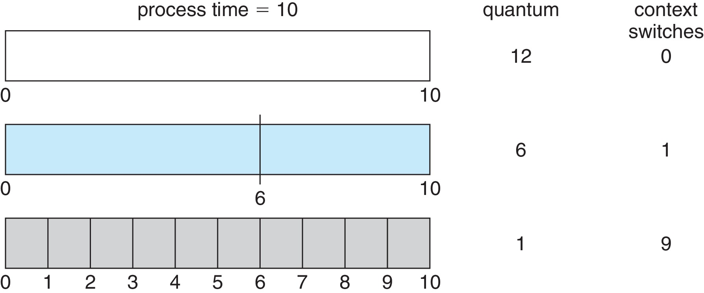
Time Quantum and Context Switch Time
How to set up quantum time considering context switch time?

Slide 14
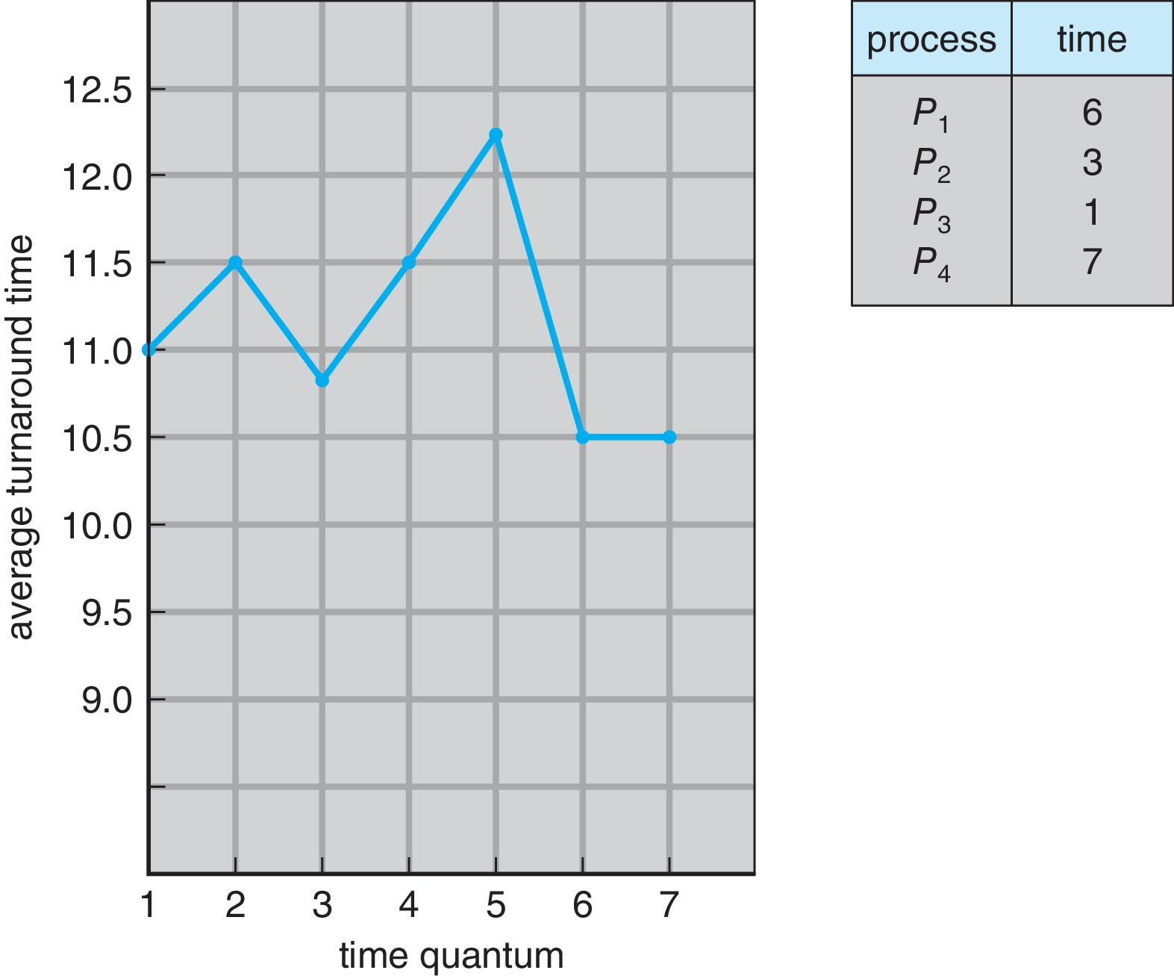
Turnaround Time Varies With The Time Quantum
80% of CPU bursts should be shorter than q

Slide 15
Priority Scheduling
A priority number (integer) is associated with each process
The CPU is allocated to the process with the highest priority (smallest integer ≡ highest priority)
Preemptive
Nonpreemptive
SJF is priority scheduling where priority is the inverse of predicted next CPU burst time
Problem ≡ Starvation – low priority processes may never execute
Solution ≡ Aging – as time progresses increase the priority of the process

Slide 16
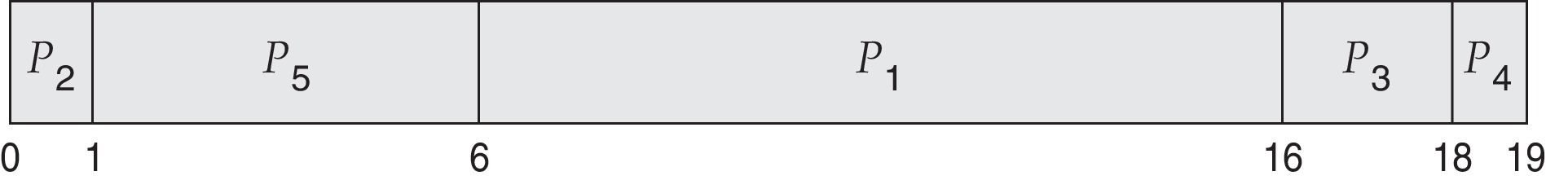
Example of Priority Scheduling
ProcessA arri Burst TimeT Priority
P₁ 10 3
P₂ 1 1
P₃ 2 4
P₄ 1 5
P₅ 5 2
Priority scheduling Gantt Chart
Average waiting time = 8.2 msec

Slide 17
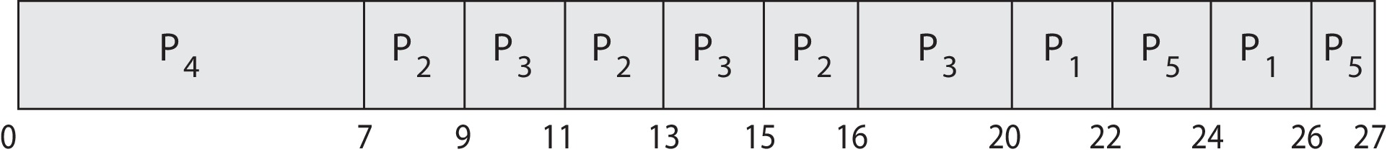
Priority Scheduling w/ Round-Robin
ProcessA Burst Time Priority Quantum
P₁ 4 3 2
P₂ 5 2
P₃ 8 2
P₄ 7 1
P₅ 3 3
Run the process with the highest priority. Processes with the same priority run round-robin (P₂ and P₃ and P₁ and P₅)
Gantt Chart wit 2 ms time quantum

Slide 18
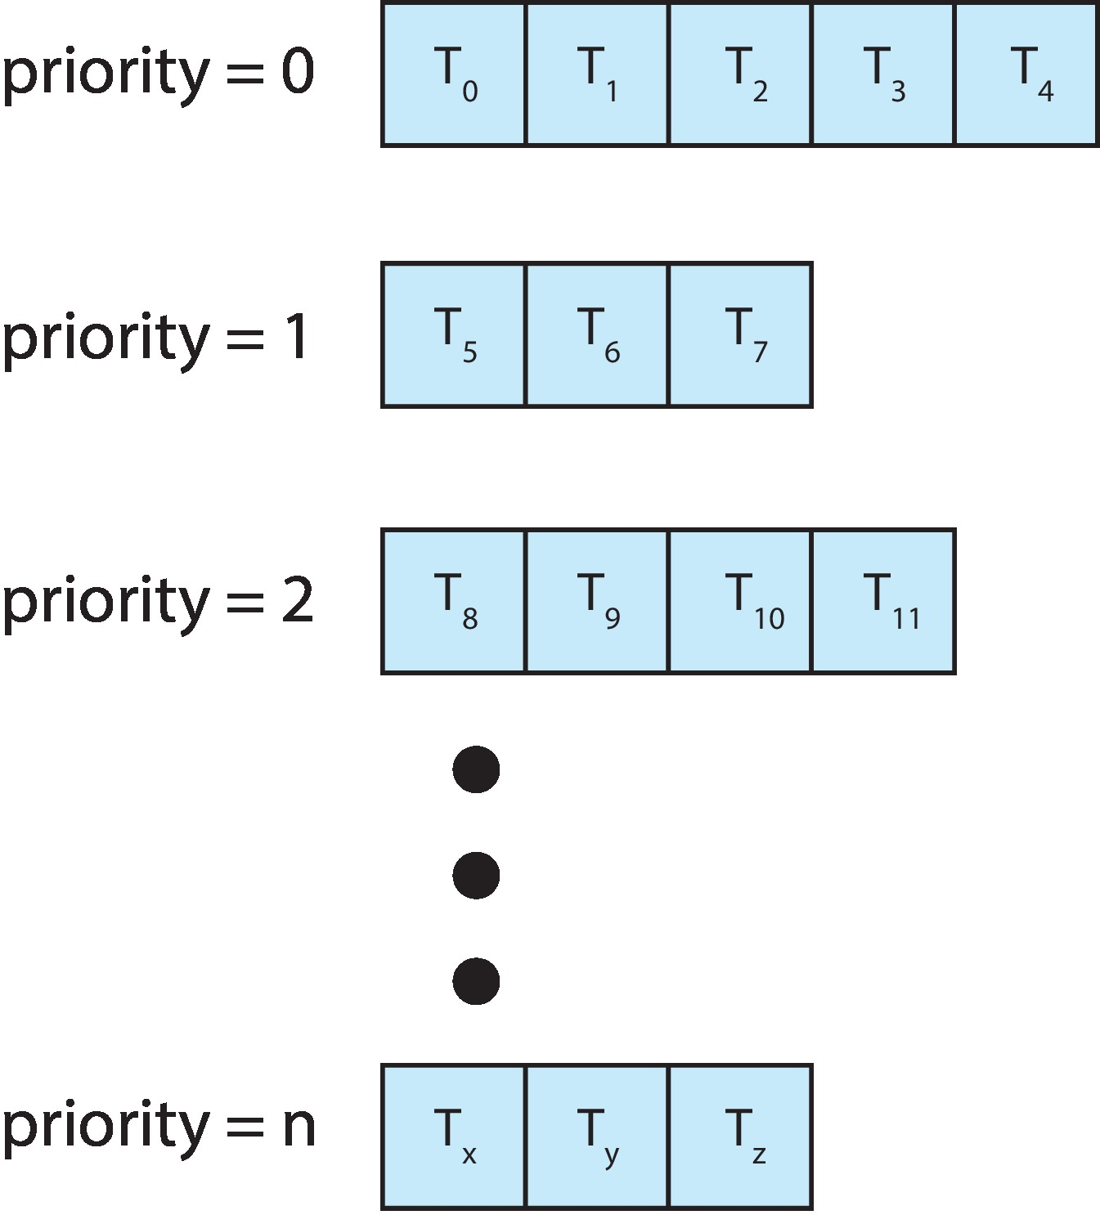
Multilevel Priority Queue
With priority scheduling, have separate queues for each priority.
Schedule the process in the highest-priority queue!

Slide 19
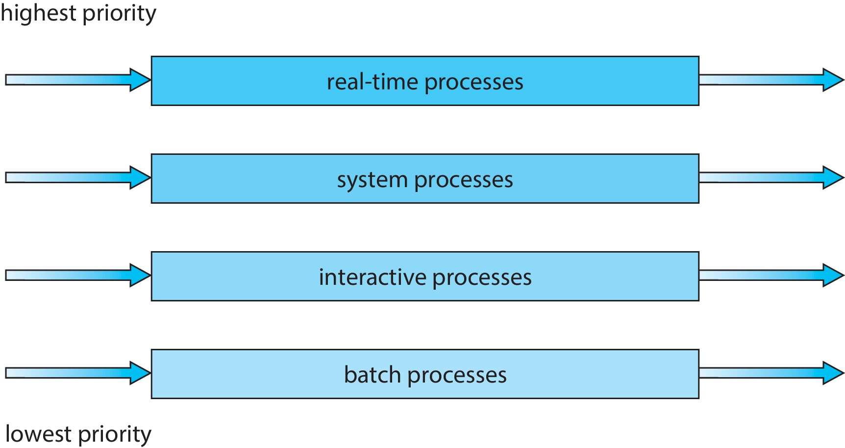
Multilevel Process Type Queue
Prioritization based upon process type

Slide 20
Multilevel Feedback Queue
A process can move between the various queues; aging can be implemented this way
Multilevel-feedback-queue scheduler defined by the following parameters:
number of queues
scheduling algorithms for each queue
method used to determine when to upgrade a process
method used to determine when to demote a process
method used to determine which queue a process will enter when that process needs service

Slide 21

Example of Multilevel Feedback Queue
Three queues:
Q₀ – RR with time quantum 8 milliseconds
Q₁ – RR time quantum 16 milliseconds
Q₂ – FCFS
Scheduling
A new job enters queue Q₀ which is served FCFS
When it gains CPU, job receives 8 milliseconds
If it does not finish in 8 milliseconds, job is moved to queue Q₁
At Q₁ job is again served FCFS and receives 16 additional milliseconds
If it still does not complete, it is preempted and moved to queue Q₂

